Slide 1


Interactive
Visualization
Team 2
Jiamin Li | Xiaohua Shi
Jiawei Xia | Xumin Zhu

Slide 2

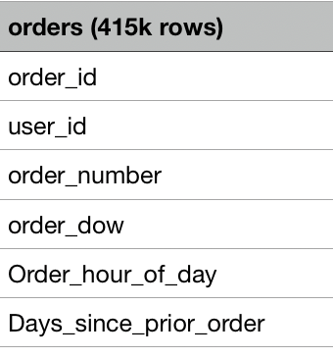
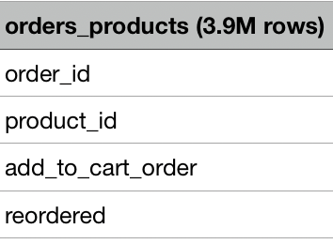

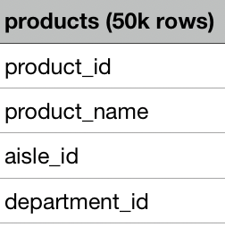
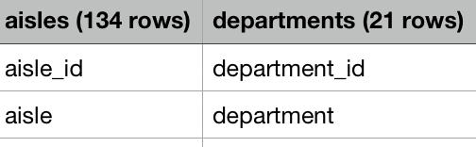

Company & Dataset
Instacart
A new way of life
Shop favorite local grocery stores
Schedule a delivery
Get groceries delivered to you!
Intense competition
Continuous data-driven business improvement to meet customer needs
Dataset(2017)

Slide 3




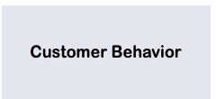



Motivation
Sales Team
Executive Team
How’s the business going?
What’s the peak time?
Schedule of salespersons?
Customer segmentation?
Value proposition?
Marketing Team
Data Science Team
What are popular products?
What kind of campaigns should be launched?
Possible cross-sale / up-sale?
Improvement for the recommendation algorithms?

Slide 4




Usability Test (Profile)
Construction Cost Manager
Math Ph.D
Sales Specialist
Media Operation
Software Engineer
Data Skills

Slide 5
Usability Test (Design & Summary)
Data Skills

Slide 6
Challenges
Data Skills

Slide 7



Thanks!

